Slide 2
What is CONCAT?
AI-powered software solution for mining, processing and related logistics
Visual dashboards and actionable recommendations
Optimizes operations, increases production using advanced analytics and machine learning algorithms
Automates and streamlines data collection
Five bolt-on modules

Slide 3
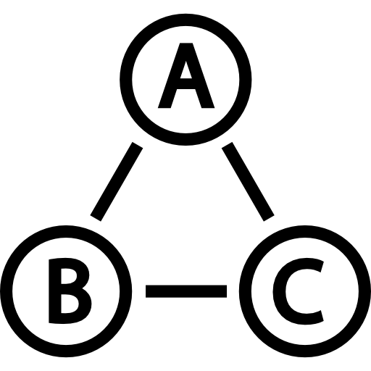


1
2
3
We begin with a simple formula
Track everything that improves excellence
Use AI to optimise for excellence
Mine Plan as starting point
Goal: maximum output
Collect data, compare with KPIs
Identify performance issues
Success influenced by fleet availability and human resources
Ensure everything works together, optimally at correct capacity

Slide 4
The Excellence Formula
Excellence
Mining performance
Engineering performance
Utilisation performance
=
x
x
Production
Availability %
Utilisation %

Slide 5
How CONCAT helps you achieve excellence
Achieve success in mining operations and meet performance indicators by addressing data blind spots and improving reporting.
Prevent contract breaches and reduce risk to the organization.
Move from a state of reactive crisis management to proactive strategic decision-making, promoting business sustainability.
Improve mining practices and increase equipment utilization while decreasing operating costs.

Slide 6
Collecting data, ensuring excellence
What you can measure with CONCAT
Mining performance | Engineering performance | Utilisation performance
Mine Plan execution Efficient loading of mined material Optimal machine usage Dig rates per operator per shift Machine deployment (e.g. recommended loader and truck matching) | On-time maintenance of machines/components Open backlogs Engineering workforce utilization Component supplier performance Stores optimally stocked (parts, tyres, consumables) Engineering legal compliance | Fleet utilization Operator utilization HR legal compliance Equipment availability and optimal use

Slide 7
Case Study: Before CONCAT
Equipment | Excellence (Full Capacity - 80%) | Mining Performance (60%) | Engineering Performance | Utilisation Performance | Actual production | # of Machines
Load Capacity |  | Current State |  |  | 754,272t
 |  | Output | Availability rate | Utilisation rate
Excavator 75t | 144t | 108t | 60% | 50% | 46,656t | 2
Excavator 90t | 208t | 156t | 60% | 50% | 235,872t | 7
Excavator 120t | 336t | 252t | 60% | 50% | 108,864t | 2
FEL | 400t | 300t | 60% | 50% | 129,600t | 2
Face Shovels | 480t | 360t | 60% | 50% | 233,280t | 3

Slide 8
Case Study: After CONCAT
(using the same fleet)
Equipment | Excellence (Full Capacity - 80%) | Mining Performance (60%) | Engineering Performance | Utilisation Performance | Actual production | # of Machines
Load Capacity |  | Current State |  |  | 754,272t
 |  | Output | Availability rate | Utilisation rate
Excavator 75t | 144t | 144t | 75% | 65% | 101,088t | 2
Excavator 90t | 208t | 208t | 75% | 65% | 511,056t | 7
Excavator 120t | 336t | 336t | 75% | 65% | 235,872t | 2
FEL | 400t | 400t | 75% | 65% | 280,800t | 2
Face Shovels | 480t | 480t | 75% | 65% | 505,440t | 3

Slide 9








5 MODULES
5. Engineering
1. Production
Machine/components
2. Human resources
Tyres
3. Stores & tooling
Oil/components
4. Cost
Legal compliance

Slide 10
5 MODULES
5. Engineering
1. Production
Machine/components
2. Human resources
Tyres
3. Stores & tooling
Oil/components
4. Cost
Legal compliance

Slide 11
How does CONCAT work?
1
2
3
Data
collection
Intelligent analysis
Reporting & recommending
Equipment sensors
Engineering data
Operator inputs
Advanced analytics
Machine learning
Pattern identification
Trend analysis
Optimisation
Predictions
Bottleneck identification
Recommendations
Accurate, timely data

Slide 12
Recommendations and reports
Predict equipment maintenance and repairs to reduce downtime
Identify bottlenecks to increase efficiency
Compare and select best-performing brands/suppliers
Eliminate unnecessary expenses to reduce costs
Address potential safety hazards to improve compliance
Provide insights into business operations and finance to improve performance
Accurate and timely data to enhance management and decision-making

Slide 13
A tale of two contractors
With CONCAT | Without CONCAT
Forward-thinking, data-driven organisation | Outdated, reactive thinking, speculation
Utilises real-time data | Data blindness, untimely/no data
Automated reporting | Spreadsheets / self-reports
Better forecasts and decisions | Breakdowns, backlogs
Early problem prediction and prevention | Unplanned maintenance
Industry-wide knowledge of component, part, product, and brand performance | Reliance on staff experience and sales rep influence
Industry-wide performance benchmarks | Reliance on staff experience and sales rep influence
Better procurement, cash flow, cost savings, increased profitability | Increased costs, lower profitability
100% contract compliance | Constant risk of non-compliance

Slide 14
Where other technology fails
Inaccurate reporting and poor decision-making
Difficulty in tracking performance and forecasting trends
Lack of automated reporting
Difficulty in identifying and addressing issues before they become problems
Expensive component failures, downtime, and high operating costs
Difficulty in making informed procurement decisions that result in cost savings
Low employee productivity and high costs due to manual data management processes
Difficulty in streamlining operations and achieving a level of efficiency

Slide 15
7 symptoms indicating you need CONCAT
Contract breaches
Poor performance
Loss of revenue
Reactive crisis management
Poor mining practices and lack of maintenance
Inefficient procurement
Unforeseen losses

Slide 16




Implementation: How to get started
1. Tailored to your needs
Tailored implementation processes and module selection based on budget and needs
2. Team players
Seamless system integration into existing operations through close collaboration.
3. Phased in approach
Client audit to identify gaps and ensure resource availability for optimal deployment
4. Like clockwork
Bespoke Implementation plan with work breakdown structure, schedule, resource plan, communication, training and risk management.

Slide 17





Implementation: How to get started
5. On-site configuration
Configure system (1-3 weeks). Align processes, requirements, system roles, load users, access rights
6. Hands-on training
Onboarding pilot period training and support. Ensure optimal use of capabilities and benefits.
7. Smooth transition
Ongoing support and smooth project handover after piloting..
8. Ongoing support
Continued support through contact centre
9. Partners I excellence
With CONCAT, you have a partner committed to optimal system performance and support at every step

Slide 18
Investment
Total investment depends on:
Scale of operation
Number of modules required
Desired speed of implementation
For estimates or quotes, speak to a CONCAT advisor.

Slide 19

Intellectual capital at your fingertips
sales@concat.co.za

